Slide 1
Crop Production Analysis in India

Slide 2
Introduction
Overview: The agriculture sector is a crucial part of the supply chain and is expected to evolve significantly with advancements in the Future Internet.
Objective: To develop a Business-to-Business collaboration platform for the agri-food sector, facilitating effective and flexible stakeholder collaboration.
Goal: Predict crop production and identify key indicators and metrics influencing crop production.

Slide 3
Details of Data
It contains Information on crop production in India over several years.
Data cleaning was performed to address any missing values and ensure accurate data types.

Slide 4
Main KPIs
Total Production: Measured in billions of tons over time.
Average Yield: Crop-wise yield per hectare.
Production by State and District
Seasonal Trends
Area vs Production

Slide 5
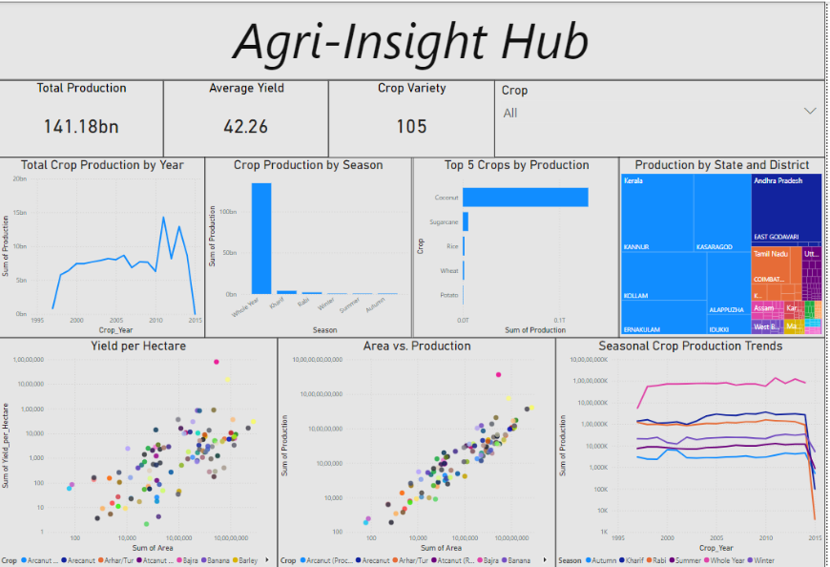
My Design

Slide 6
Thank you

